Slide 1
RWJ COVID-19 Data Analysis
PI: Luigi Brunetti and Marshall Yuan
Stats: Davit Davit, Vahe Nersisyan and Javier Cabrera
Last Edited: March 10, 2024

Slide 2
Enzyme Linked Immunosorbent Assay (ELISA)
122 samples: 38 non-COVID no-DM, 30 non-COVID DM, 35 COVID non-DM and 19 COVID DM
23 proteins
Analyzed using two-part model with marginal effects
Logistic part: odds ratio of observing a specific protein in one group vs another
Gaussian part: average estimated concentration of a specific protein given ithas been observed
Marginal effect: average estimated concentration of a specific protein from the two models combined

Slide 4
Average Marginal Effect from Two-Part Model
INFa and IL-10 elevated in No COVID/DM vs No COVID/No DM
IL-4, IL-5 and IP-10 (CXCL-10) had higher concentration in DM patients’ samples (both, COVID and non-COVID) vs No COVID/No DM
DPPIV had lowere concentration in DM patients’ samples (both, COVID and non-COVID) vs No COVID/No DM
IL-6 borderline significant increase in COVID/DM vs No COVID/No DM

Slide 5
Data Quality Control: Clinical and ELISA
“COVID study Master sheet w ELISA data July 2023-2.csv” file contains 109 variables collected on 183 patients. New combined data from Lu on 11/16/23: luigi_covid19_clinical_data.csv
NOTE 1 (9/19/23): the Controls were admitted to RWJ but without COVID diagnosis. Lu will get reasons for admission (DX1) and admission dates.
For COVID patients primary DX was COVID (OK)
We are working on getting DX1 ICD-10 Code for controls. (OK)
NOTE 2: Lu to get the labels: i) confirm Race coding 0-4; ii) Booster coding 0, 1 or 9, iii) Smoking History 0, 1 or 2; iii) Age_Category 0-4
See key on next slide (not everything is there. Vaccinated (0, 1, 9), etc, levels are different in data compared to the keys. See the code) The other vars were relabeled on 11/16/23!
NOTE 3: Patient 7247980 was marked “COVID-Positive” instead of 1-3 in Inpatient=1, ER=2, OP=3, and had most data missing. Removed from the analysis.
Agree with this, remove (DONE)
NOTE 4: last 21 columns should contain protein readouts but are empty. Got those from “COVID study Master sheet w ELISA data July 2023-3.csv”
Not sure what the question is here. Are the data missing or you found them? (this is note for myself, we have the data split between 2 files)
Out of 141 Patient IDs in “COVID study Master sheet w ELISA data July 2023-3.csv”, the following 19 were not found in the Clinical Data: "4733464“, "1424090" , "5104137" , "7247980“, "5061837_1" , "5061837_2“, "562141“, "10912836“, "5042447“, "865833“ , "813049“, "464811“, "699755“, "593789“, "98014“, "117012“, "507344“, "322890“, "no tag“.
Will see if we can manually pull . New data aligns Real IDs so this issue is resolved
Patients 341512, 3066280, 4875507 and 8134517 have 2 ELISA samples each. I used just one of two but if we don’t remove them, we need to average them.
I think average is fine. There were some duplicates in the set.
In total, 122 IDs in ELISA were matched to Clinical dataset.
Sounds right, in general samples that were stored in Trizol could not have ELISA run on them because of interference with the assay.

Slide 6
Key |  |  |  |  |  | WHO Ordinal Scale for Clinical Improvement (OSCI)
Smoking History | 0 = never | 1= former | 2 =current |  |  | Mild Disease | 1 | Ambulatory, No limitation of activities
Race | 0 =white | 1 = black | 2 = indian/asian | 3 = other |  |  | 2 | Ambulatory, Limitation of activities. Home O2 requirement, or both
Sex | 0=female | 1 = male |  |  |  |  | 3 | Hospitalized, No O2 therapy + not requiring medical care
Vaccinated | 0=Pfizer | 1 = Moderna | 3 = JNJ | 4 = other |  |  | 4 | Hospitalized, No O2 therapy, but requiring ongoing medical care
Full Dose Anticoagulation | 0=not received | 1=received | 2=Enoxaparin 1mg/kg Q24H |  |  | Severe Disease | 5 | Hospitalized, Any supplemental O2
 | Has 2 hospital admission |  |  |  |  |  | 6 | Hospitalized, Requiring NIV or HFNC
 | negative COVID |  |  |  |  |  | 7 | Hospitalized, IMV or ECMO
CCI | Charlson Comorbidity Index criteria |  |  |  |  |  | 8 | Death
Metabolic Syndrome | Metabolic Syndrome Criteria
Medications | Medication Data
Metabolic Syndrome Criterion
Patients with metabolic syndrome were identified from admission data using modified World Health Organization criteria17 as previously described7 and as having at least 3 of the following: prediabetes (hemoglobin A1c ≥5.7% [to convert to proportion of total hemoglobin, multiply by 0.01]), history of diabetes, or diabetes medication use; obesity (body mass index [BMI; calculated as weight in kilograms divided by height in meters squared] ≥30); history of hypertension or antihypertensive medication use; and serum triglyceride (TG) level of 150 mg/dL or greater (to convert to millimoles per liter, multiply by 0.0113), serum high-density lipoprotein (HDL) level less than 50 mg/dL for women and less than 40 mg/dL for men (to convert to millimoles per liter, multiply by 0.0259), or cholesterol-lowering medication use with history of dyslipidemia.

Slide 7
Data Quality Control: Gene Expressions
“gene_count.xls” (57 samples) and “gene_count_Additional.txt” (45 samples) contain expression data of 58,735 transcripts, and 10 gene description columns. Hence, 102 samples.
NOTE 5 (9/19/2023): in RNA-seq, some COVID patients are marked as non-COVID as COVID was detected later. Use clinical data labels for all data (“Study Group”)
Correct, they may have later come up positive (OK)
The following 10 patients were found in RNA-seq data but not in clinical data: 464811, 507344, 7907555, 05042447, 04886363, 01379494, 07215440a and 07215440b, 75435 and 831760
These match the samples from ELISA with no clinical data. The lab may have included these
NOTE 6: “Real ID” are used for linking all datasets
Correct (OK)
NOTE 7 (9/19/2023): Lu to check mismathced IDs as well as if 07215440a and 07215440b were taken from the same patient.
Yes, same patient (OK)
Which IDs are mismatched? (I meant the 10 IDs above)
91 patients had no RNA-seq data.
That sounds correct, some of the samples were poor quality so could not get enough RNA exracted.

Slide 8
Data Quality Control: Lab Work and Medications
In the clinical data, the following labwork results are recorded: "HbA1c“, "Vit_D_level“, "ALT“, "AST“, "hs-CRP“, "CRP“, "Fibrinogen“, "D-Dimer“, "ESR“, "Ferritin“, "LDH“, "Lactic Acid“, "PCT“, "Glucose Lvl" , "Screat“
Correct
There are values outside of limits of detection/limits of quantification (LOD/LOQ). It Table 1, currently these values were set to NA as I converted all values to numeric (i.e., nonnumeric values like “>700” automatically became NA). We need to conver them to numeric but mark them as censored, and think how we will deal with themin the analyses.
Would it help to provide the upper and lower limit of quantitation for each assay?
The following medications were recorded: "tocilizumab“, "remdesivir“, "dexamethasone" "methylprednisolone“, "prednisone“, "hydrocortisone“, "azithromycin“, "hydroxychloroquine" "regeneron“, "ACEis“, "ARBs“, "ARNIs“, "Insulin“, "Metformin“, "Glimepiride" "Glipizide“, "Sitagliptin“, "Full Dose Anticoagulation“, "Prophylactic Anticoagulation"
Yes
Medicatins most likely will need to be grouped into larger categories. We will work with Lu on that.
Corticosteroids (methylprednisone, prednisone, hydrocortisone)
RAAS agents (ACEi, ARBs, ARNIs)
Biguanides (metformin)
Sulfonylureas (glimepiride, glipizide)
DPP-IV (sitagliptin)
If needed could also condense biguanides, sulfonylureas, and DPP-IV agents into a oral hypoglcemic class.
Tocilizumab
Remdesivir
Anticoagulation (full dose and prophylactic dose)
I think we should keep them split out
QUESTION: Can Lu get follow-up (30 or 90 days), death or readmission?
Yes, manual pull. Will take a week or so.

Slide 9
Death by COVID
12 out of 110 COVID (10.9%) and 3 out of 72 (4.2%) Non-COVID patients died in hospital
Dead | Any DM
Dead | No | Yes | Sum
No | 70 | 28 | 98
Yes | 6 | 6 | 12
Sum | 76 | 34 | 110
Difference in death rate by DM (Any Diabetes) in COVID patients only was not significant, with Chi-square test p=0.236

Slide 10
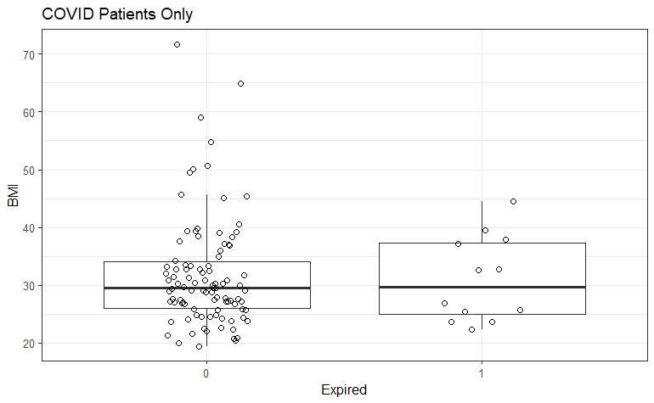
Death by OBESITY and BMI in COVID
Dead | Obese
Dead | No | Yes | Sum
No | 52 | 46 | 98
Yes | 6 | 6 | 12
Sum | 58 | 52 | 110
Death vs. Obesity Chi-square test was not significant (p>0.999)
Death vs. BMI t-test was not significant (BMI of dead = 31.0 vs. of alive = 31.7, p=0.760)

Slide 11
Death vs. ICU COVID
Dead | Critical Care
Dead | No | Yes | Sum
No | 92 | 6 | 98
Yes | 5 | 7 | 12
Sum | 97 | 13 | 110
Death vs. Critical Care (ICU) Chi-square test was significant (p<0.001)
The odds ratio of a COVID patient dying after being admitted to ICU was 21.5 compared to a COVID patient not admitted to ICU.

Slide 12
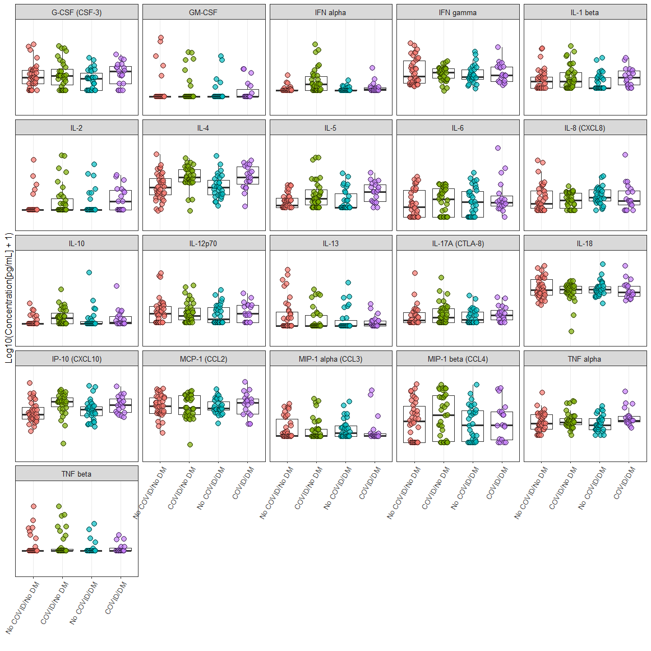

Slide 13
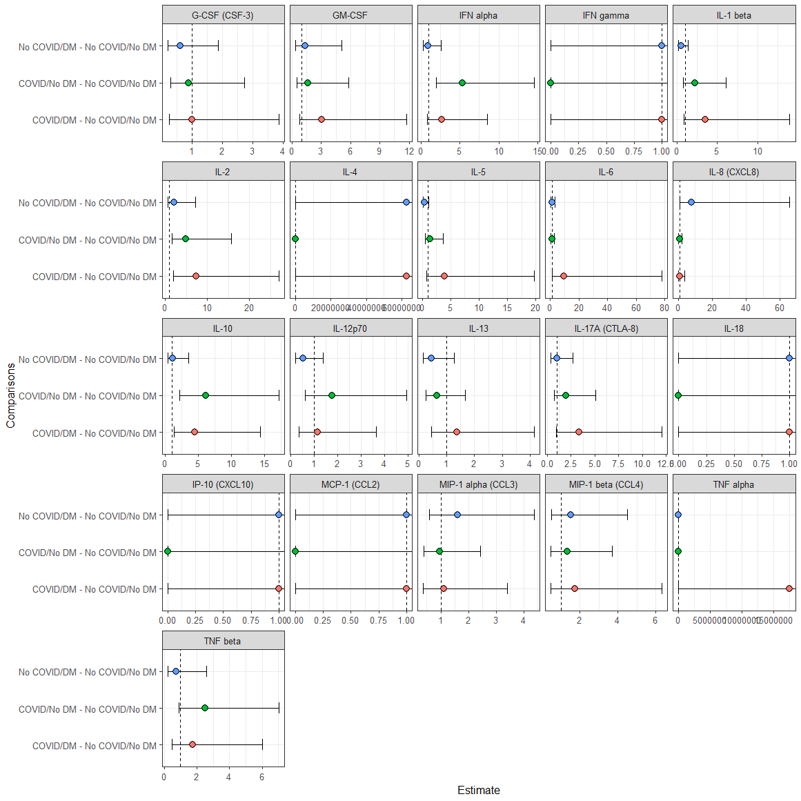
Logistic

Slide 14
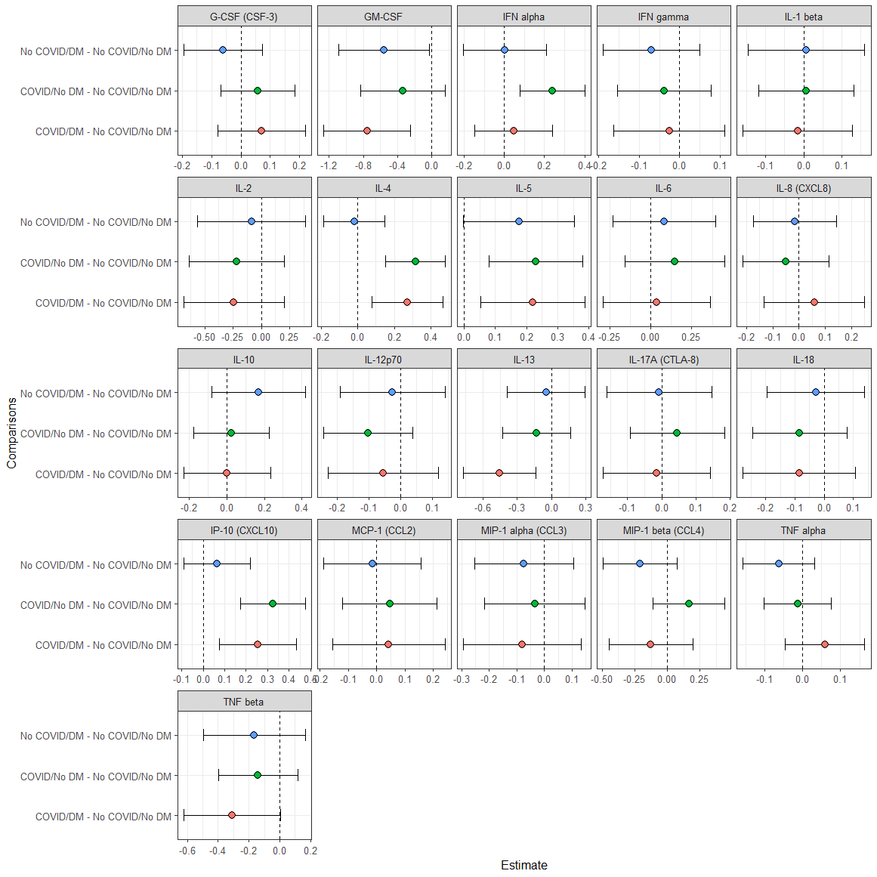
Gaussian

